Slide 1
New Solutions for Supporting Adrenal Health
Lee Carroll B.Sc.

Slide 2
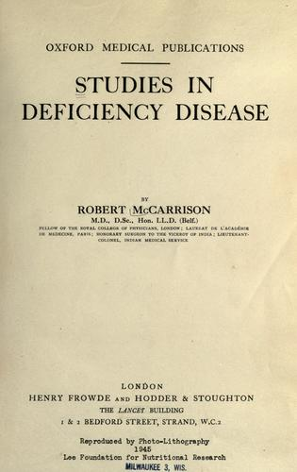
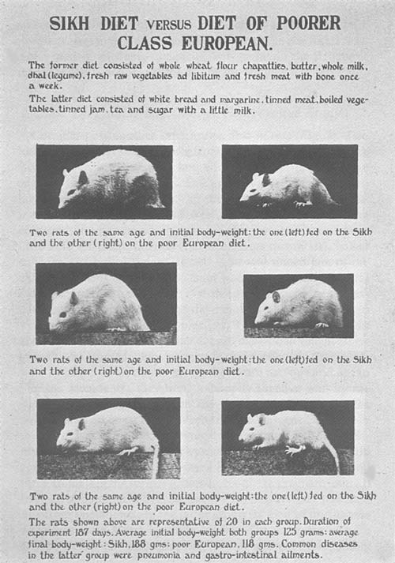
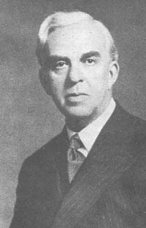
http://www.archive.org/details/cu31924080041787
Notes:
He received a Knighthood in recognition of his groundbreaking research on nutrition and the endocrines
Stress and fatigue have become common problems for the average person in Western society. This webinar will examine and review the key foundational whole food supplements and herbs that help restore functional balance to adrenal glands.
In his 1921 classic, Studies in Deficiency Disease, Major General Sir Robert McCarrison MD (1878 – 1960), conclusively demonstrated that the adrenal glands were the first organ in the body to react to the effects of malnutrition
Nutrition and National Health The Cantor Lectures delivered before The Royal Society of Arts 1936 by Sir Robert McCarrison
Deficiency of vitamin C may lead to haemorrhages in various parts of the body, to sallowness and other affections of the skin, to fragility of bones, swelling of joints, imperfections in the teeth, unhealthy gums, congestion of the bladder, changes in the bone-marrow, gastro-intestinal disorder (such as duodenal ulcer -- in guinea-pigs), and to latent or manifest scurvy. Like vitamin B it has a specific relation to the adrenal glands -- its chief storehouse in the body -- which undergo enlargement when it is deficient in the diet. This observation, which I made in 1919, calls to mind the enlargement of the thyroid gland -- the chief storehouse of iodine in the body -- which results from deficiency of iodine. Like proteins and vitamins A and B, but in its own particular way, vitamin C has an anti-infective action. It has, for instance, recently been shown that guinea-pigs, fed on diets poor in vitamin C but not sufficiently lacking in it to cause manifest scurvy, develop the symptoms characteristic of rheumatic fever when streptococci, isolated from cases of this disease in human beings, are administered to them; guinea-pigs
Vitamin B1 is intimately concerned with the maintenance of neuromuscular efficiency throughout the body, such, for instance, as that of the stomach, the colon and the heart. Within an hour of the administration of a dose of the International Standard Preparation of the vitamin to a person whose diet is low in this factor, but who may show no obvious sign of its lowness, the heart's action is markedly improved and remains so for approximately four hours, when the good effect wears off. If, however, the same dose be given to a person whose diet contains enough of it, no effect on the heart is observable on electro-cardiographic examination. In animals (pigeons and rats), under experimental conditions, its deficiency gives rise to marked slowing of the heart's action (bradycardia) amounting sometimes to 'heart-block'. It causes also a slowing down of respiration and a fall in body temperature and in blood pressure. Its deficiency has a specific effect on the adrenal glands (causing them to undergo hypertrophy) and through them, as well as more directly, on the sympathetic nervous system.

Slide 3
Sir Robert McCarrison MD
“The functional perfection of the adrenal glands is dependent upon the balance of the food and upon the quality and quantity of its vitamins”
“An intimate relationship exists between the adrenal glands and the meta-bolic processes of the animal organism”
“Each vitamin exercises a specific influence on the adrenal glands; the effect of their deprivation on these organs is one of the most outstanding features of deficiency disease”
Notes:
Two main facts have emerged from the studies in this and the two preceding chapters:

Slide 4
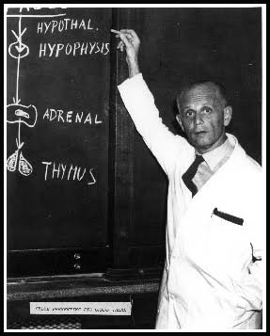
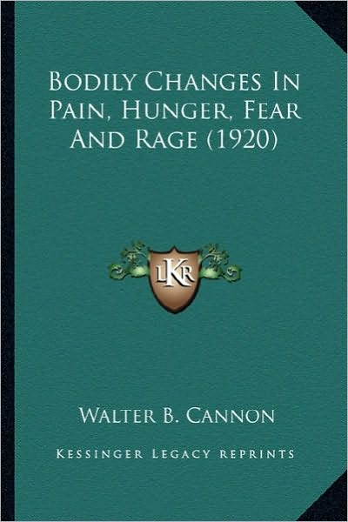
Stress - Historical Context
Hans Selye (1907-1982)
Observed that the same characteristics and physiological responses occurred in rats subjected to a variety of intense stimuli
  adrenal enlargement, thymus and spleen atrophy and GIT ulcers
Termed the series of responses the General Adaption Syndrome (GAS)
Goldstein DS, Kopin IL. Stress 2007; 10(2): 109-120
Notes:
Cannon’s work was then extended by Hans Selye (1907-1982)
Stress resets the body to meet an emergency
eustress is productive stress and helps prepare for certain challenges
distress is when levels of stress are harmful eg decreased resistance to infection
Walter B Cannon (1871-1945)
In 1915 coins the term “fight or flight mechanism” to describe associated changes in adrenal gland secretions
In 1926 coined the term “homoeostasis” to describe the maintenance of physiological variables within certain ranges eg blood glucose, O₂ tension and core temperature

Slide 5
General Adaptation Syndrome
SELYE’S STRESS MODEL
normal
resistance
state
anabolic phase
catabolic phase
alarm phase
Phase 1
resistance phase
Phase 2
exhaustion phase
Phase 3
Notes:
According to Selye there is a finite amount of “adaptation energy” which declines with increasing or continuous exposure to stressors
One of the sequelae to this decrease is faulty adaptation and disease

Slide 6
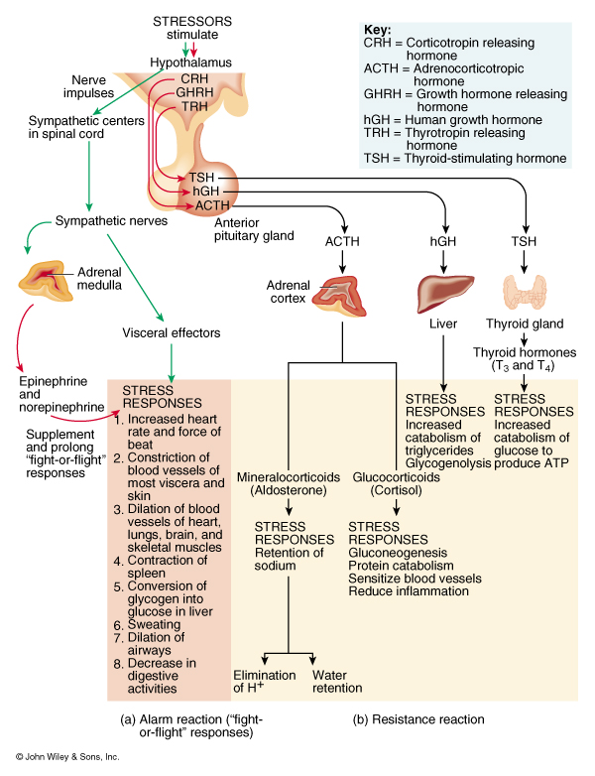
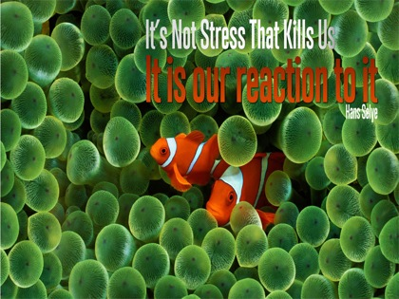
Notes:
The test book full scope of the stress response
Fight or flight
Initiated by hypothalamic stimulation of the sympathetic portion of the ANS and adrenal medulla (sympathoadrenal)
increases circulation
Na+ retention → increased BP and fluid volume
promotes ATP synthesis
nonessential body functions are inhibited
eg digestive, urinary and reproductive
EXhaustion
Resources of the body have become depleted
Resistance stage cannot be maintained
Prolonged exposure to resistance reaction hormones
wasting of muscle
suppression of immune system
ulceration of the GI tract
failure of the pancreatic beta cells

Slide 7
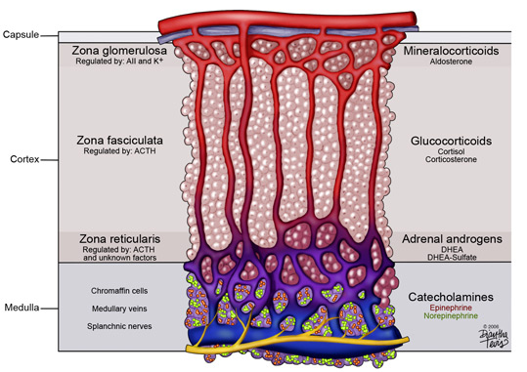
Adrenal Hormones
Capsule
Zona glomerulosa
Regulated by K⁺
Mineralocorticoids
Aldosterone
Zona fasiculata
Regulated by ACTH
Glucocorticorticoids
Corticosterone
Cortisol
Cortex
Adrenal androgens
DHEA
DHEA-Sulfate
Zona recticularis
Regulated by ACTH
Chromaffin cells
Medullary veins
Splanchnic nerves
Catecholamines
Epinephrine
Norepinephrine
Medulla
Notes:
Highlight the hormones involved and say the focus today is mainly with cortisol
Aldosterone Functions- increase reabsorption of Na⁺ with Cl⁻ , bicarbonate and water following it and promotes excretion of K⁺ and H⁺
Cortisol Functions = help regulate metabolism
increase rate of protein catabolism & lipolysis
conversion of amino acids to glucose
stimulate lipolysis
provide resistance to stress by making nutrients available for ATP production
raise BP by vasoconstriction
anti-inflammatory effects reduced (skin cream)
reduce release of histamine from mast cells
decrease capillary permeability
depress phagocytosis

Slide 8
Cortisol Pathophysiology
Glucocorticoids are heavily involved in human pathophysiology and influence life expectancy
Anxiety
Depression
Insomnia
Chronic pain and fatigue syndromes
Obesity
Metabolic syndrome
Essential hypertension
T2 Diabetes
Atherosclerosis with its cardiovascular sequelae
Osteoporosis
Autoimmune disease
Inflammatory and allergic disorders
Sickness syndrome
Chrousos, GP, and Kino, T, Glucocorticoid Signaling in the Cell: Expanding Clinical Implications to Complex Human Behavioral and Somatic Disorders Ann N Y Acad Sci.
2009 October ; 1179: 153–166
Notes:
In addition to its role as a stress response hormone, cortisol plays many key roles in almost every physiological system:
Central nervous system
Activity and direction of energy metabolism
Maintenance of a proper cardiovascular tone
Activity and quality of immune system and inflammatory responses
Growth and reproduction

Slide 9
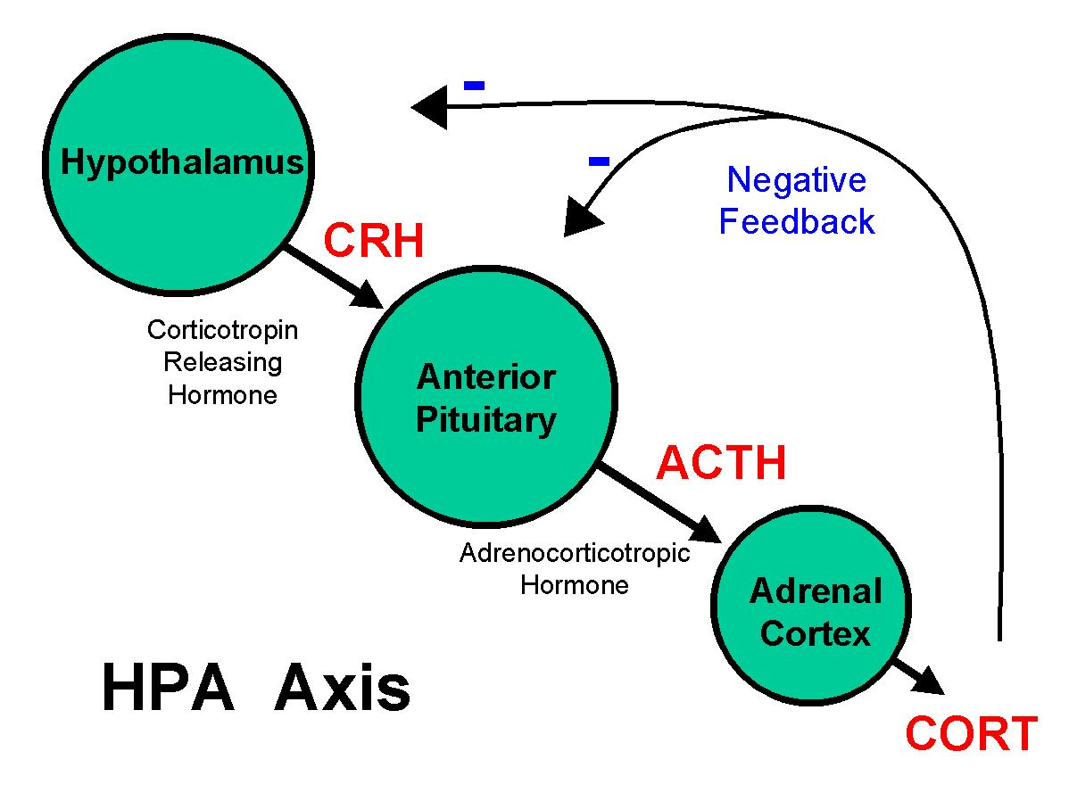
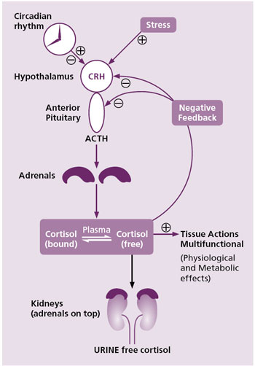
Notes:
Negative Feedback Regulation of Cortisol
High CRH and low cortisol promote release of ACTH
Complicated by hyper and hyposensitivity of target tissue
Clinically we want to create harmony in the HPA axis
Acute ethanol administration activates the hypothalamo-pituitary-adrenal axis
Animal studies show that ethanol can decrease hypothalamic sensitivity to glucocorticoid feedback with a resulting hypersecretion of CRH
Liver effects of ethanol may decrease CBG synthesis and increase free cortisol concentrations

Slide 10
Cortisol Pathophysiology
HPA axis activity or sensitivity
  hypothalamus and pituitary
Cortisol activity or sensitivity
  Receptor based
  Enzyme based
Responsiveness of the target tissues to cortisol is highly variable
Notes:
Very very complicated. This is overly simplified and focused on issues that can be supported with evidenced based herbal medicine
There are now a host of human states associated with tissue-specific pathologic glucocorticoid target tissue changes. These include allergic, autoimmune, inflammatory and lymphoproliferative disorders.

Slide 11
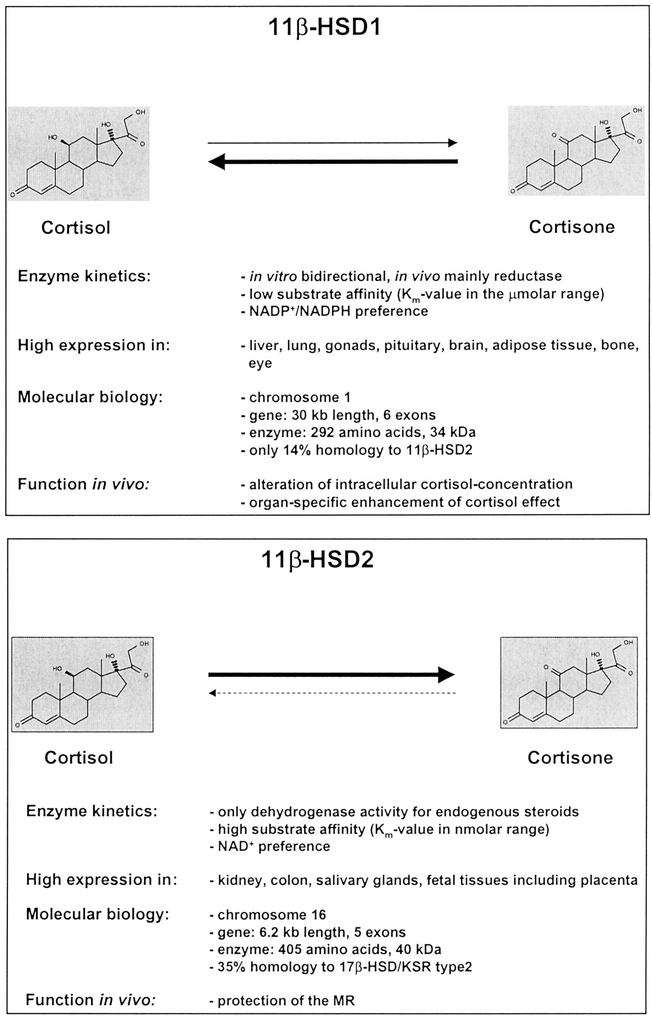
Function:
Alteration of intracellular cortisol concentration
Organ specific enhancement of cortisol effect
High expression: Liver, adipose tissue, lung, gonads, pituitary, bone, eye
Notes:
Licorice inhibits this enzyme
11beta-hydroxysteroid dehydrogenase type 1 inhibitors as promising therapeutic drugs for diabetes: status and development.
Ge R, Huang Y, Liang G, Li X.
Source
School of Pharmacy, Wenzhou Medical College, 1# Jingguan Road, College Town, Wenzhou City 325035, China.
Abstract
Glucocorticoids (GC) play a fundamental role in controlling physiologic homeostasis and, when present in excess, can have a detrimental impact on glucose control, blood pressure and lipid levels. The oxidoreductase 11beta-hydroxysteroid dehydrogenase type 1 (11beta-HSD1) mainly catalyzes the intracellular regeneration of active GCs (cortisol, corticosterone) from inert inactive 11-keto forms (cortisone) in liver, adipose tissue and brain, amplifying local GC action. Multiple lines of evidence have indicated that 11beta-HSD1-mediated intracellular cortisol production may have a pathogenic role in type 2 diabetes and its co-morbidities. The 11beta-HSD1 becomes a novel target for anti-type 2 diabetes drug developments, and inhibition of 11beta-HSD1 offers a potential therapy to attenuate the type 2 diabetes. In the past several years, a lot of 11beta-HSD1 inhibitors have been designed, synthesized, screened and discovered. Lowering intracellular glucocorticoid concentrations through administration of small molecule 11beta-HSD1 selective inhibitors, significantly attenuates the signs and symptoms of disease in preclinical animal models and clinical trials of diabetes and metabolic syndrome. Among published inhibitors, DIO-902 from DiObex Inc. and INCB13739 from Incyte Inc. are now being investigated under Phase 2B clinical trials. However, the selectivity of current selective 11beta-HSD1 inhibitors has been just focused on the difference between 11beta-HSD1 and 11beta-HSD2. They inhibit the bi-directional activities of 11beta-HSD1, both 11beta-HSD1 reductase (major) and oxidase (minor). In our lab, we have recently found novel chemicals that not only inhibit 11beta-HSD1 reductase activity but also increase its oxidase activity without inhibition against 11beta-HSD2. We propose that this dual modulation on 11beta-HSD1 may provide a better therapeutic strategy for type 2 diabetes.

Slide 12
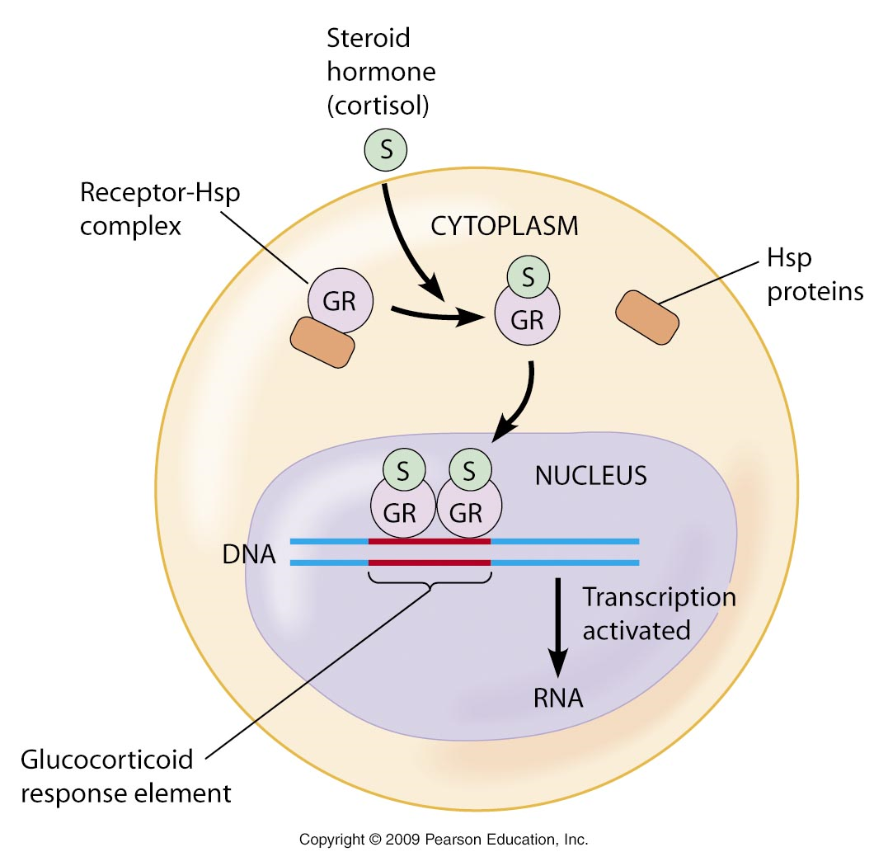
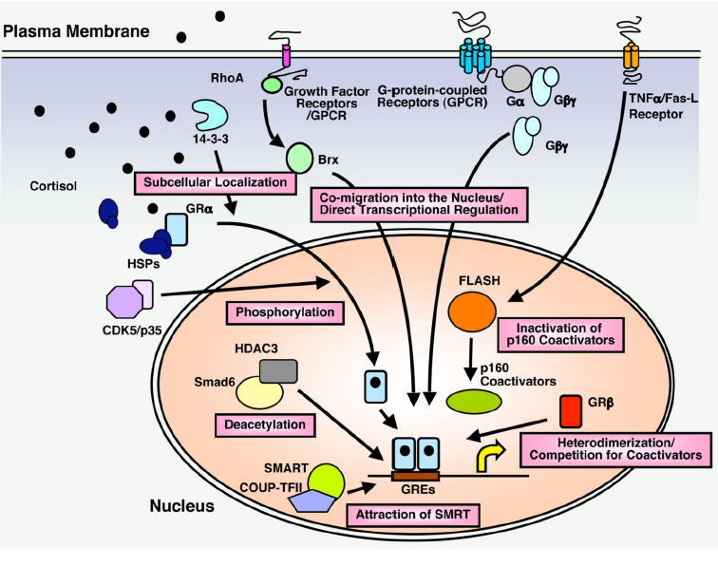
HSP and Cortisol
Notes:
The numerous actions of glucocorticoids are mediated by a set of at least 16 glucocorticoid receptor (GR α and β) isoforms (256 combinations)
GR resides in the cytosol complexed with a variety of proteins including heat shock protein 90 (hsp90), the heat shock protein 70 (hsp70)

Slide 13
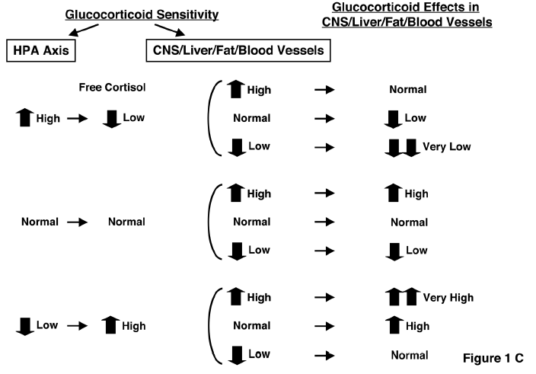
HPA Axis/Cortisol Sensitivity
HPA Axis
CNS/Liver/Fat/Blood Vessels
Free Cortisol
A
A
A
a
A
A
A
a
A
A
A
a
Notes:
Visceral Adipose
Hypothalamic neurons

Slide 14
Central Nervous System
Cortisol excess or hypersensitivity
  Insomnia
  anxiety
  depression
  defective cognition
Cortisol deficiency or resistance
  Fatigue
  Somnolence
  Malaise
  defective cognition
Notes:
Inflammation/immunity - GC excess or Hypersens
Immune suppression, anti-inflammation, vulnerability to certain infection and tumors
Inflammation/immunity- GC deficiency or resistance
+Inflammation, +autoimmunity, +allergy
Fat - GC excess or Hypersensitivity
Accumulation of visceral fat (metabolic syndrome)
Fat - GC deficiency or resistance
Loss of weight, resistance to weight gain

Slide 15
Blood Vessels
Cortisol excess or hypersensitivity
  Hypertension
Cortisol deficiency or resistance
  Hypotension
Notes:
Inflammation/immunity - GC excess or Hypersens
Immune suppression, anti-inflammation, vulnerability to certain infection and tumors
Inflammation/immunity- GC deficiency or resistance
+Inflammation, +autoimmunity, +allergy
Fat - GC excess or Hypersensitivity
Accumulation of visceral fat (metabolic syndrome)
Fat - GC deficiency or resistance
Loss of weight, resistance to weight gain

Slide 16
Adipose Tissue
Cortisol excess or hypersensitivity
    Accumulation of visceral fat
    Metabolic syndrome
Cortisol deficiency or resistance
    Loss of weight
    Resistance to weight gain
Notes:
Inflammation/immunity - GC excess or Hypersens
Immune suppression, anti-inflammation, vulnerability to certain infection and tumors
Inflammation/immunity- GC deficiency or resistance
+Inflammation, +autoimmunity, +allergy
Fat - GC excess or Hypersensitivity
Accumulation of visceral fat (metabolic syndrome)
Fat - GC deficiency or resistance
Loss of weight, resistance to weight gain

Slide 17
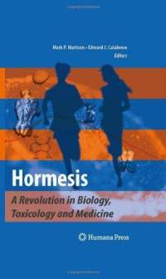
What Doesn’t Kill You
Makes You Stronger!
Hormesis
Stimulatory or beneficial effects at low doses and inhibitory or toxic effects at high doses
Hormesis is now the standard terminology used to describe the beneficial adaptive response of cells and organisms to moderate stress
Notes:
What Doesn’t Kill You Makes You Stronger
The term Hormesis was originally coined by toxicologists to describe an agent that is able to induce biologically opposite effects at different doses
Royale Lee
Vitamin A

Slide 18
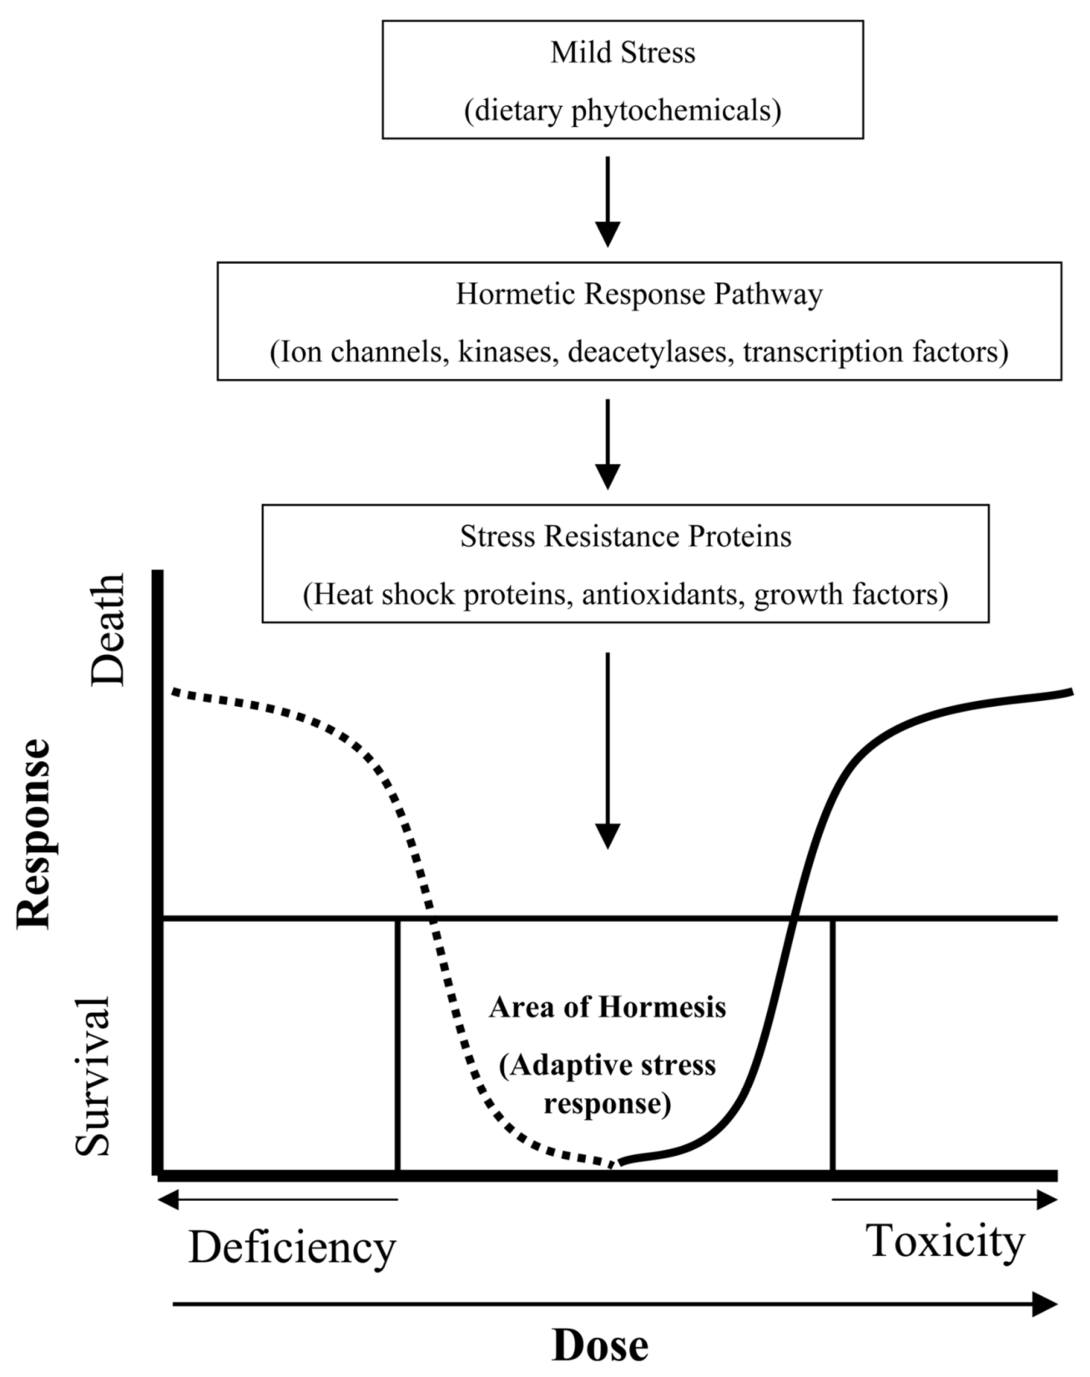

Slide 19
How is Moderate Stress Beneficial?
Mild stress induces the activation of signalling pathways, leading to intrinsic changes conferring resistance to a more severe stress
The stress-inducing agent elicits molecular responses that not only protect the cell against higher doses of the same agent, but also against other agents or even less specific stressors including oxidative, metabolic and thermal stress
They can even repair existing damage
Notes:
How can exposure to low levels of toxins or other stressors have beneficial effects?
The answer lies in the defense molecules the body calls up in response to threats

Slide 20
Hormesis
Major components of the hormetic response include various stress resistance proteins such as heat shock proteins (HSP), sirtuin1, growth factors and cell kinases
Classical examples of hormetic stress are exercise and calorie restriction
Many phytochemicals consumed in our diet are hormetic:
  Ferulic acid from tomatoes, sweet corn, rice
  EGCG from Green tea
  Curcumin from Turmeric
  Sulforafane and isothiocyanate from cruciferous vegetables
Notes:
Hormesis is probably the universal tonic and perhaps the true elixir of youth

Slide 21
Hormesis and HSP
HSP are produced when cells are exposed to stress
Their job is to protect (chaperone) other proteins from damage by binding to them and shielding them from attack
HSP play an important role in the conservation & maintenance:
  Protein homeostasis
  The cellular stress response
  Aging
Mattson M, Calabrese E. Best in small doses. The New Scientist 2008; 199(2668): 36-39
Notes:
These stressors have the ability to denature informational proteins from RNA that are vital in the maintenance of homeostasis

Slide 22
Adaptogens and Hormesis
Adaptogens are herbs that help the body better adapt to stressors by fine-tuning the stress response
The stress–protective effect of adaptogens is the result of the adaptation of the organism to the mild stressful effects of the adaptogen
Adaptogens are Hormetic
Notes:
The stress–protective effect of adaptogens is not the result of inhibition of the stress response of an organism, but actually the result of the adaptation of the organism to the mild stressful effects of the adaptogen

Slide 23
Adaptogens and Hormesis
The regular consumption of adaptogens gives rise to an adaptogenic or stress–protective effect in a manner analogous to repeated physical exercise, leading to prolonged state of non-specific resistance to stress and increased endurance and stamina under extreme conditions
Notes:
Animal experiments have shown that adaptogens increase the release of HSP72 under stress

Slide 24
The MediHerb Adaptogens
Astragalus Complex
Bacopa Complex
Eleuthero
FemCo
Gotu Kola Complex
HerbaVital
LivCo
Nevaton
Rhodiola & Ginseng Complex
Thyroid Complex
Withania Complex

Slide 25
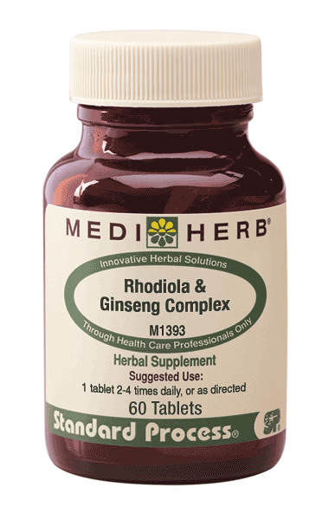
Rhodiola & Ginseng Complex
Rhodiola root 20:1 extract 150 mg
from Rhodiola rosea root 3.0 g
Containing rosavins 4.5 mg
and salidroside 1.5 mg
Korean Ginseng root 5:1 extract 100 mg
from Panax ginseng root 500 mg
Containing ginsenosides
as Rg₁ and Rb₁ 8.4 mg
Suggested Dosage: 1 tablet 2-4 times per day
Notes:
Adaptogens are herbs that help the body better adapt to stressors
The stress–protective effect of adaptogens is not the result of inhibition of the stress response of an organism, but actually the result of the adaptation of the organism to the mild stressful effects of the adaptogen
Adaptogens are Hormetic
The repeated administration of adaptogens gives rise to an adaptogenic or stress–protective effect in a manner analogous to repeated physical exercise, leading to prolonged state of non-specific resistance to stress and increased endurance and stamina under extreme conditions
Animal experiments have shown that adaptogens increase the release of HSP72 under stress

Slide 26
Rhodiola and HSP
Serum HSP ↑ 2.8 times in mice forced to swim
Serum HSP ↑ 6 times in mice given a combination of Rhodiola, Eleuthero and Schisandra extracts at human equivalent doses (1g/150lb body weight/day) for 7 days
Serum HSP ↑ 13 times in mice given herb combo and forced to swim
The time to exhaustion when swimming ↑ 7 times, from 3 mins to 21 mins, in mice taking the herb combo

Slide 27
HSP and Cortisol
Notes:
The numerous actions of glucocorticoids are mediated by a set of at least 16 glucocorticoid receptor (GR α and β) isoforms (256 combinations)
GR resides in the cytosol complexed with a variety of proteins including heat shock protein 90 (hsp90), the heat shock protein 70 (hsp70)

Slide 28
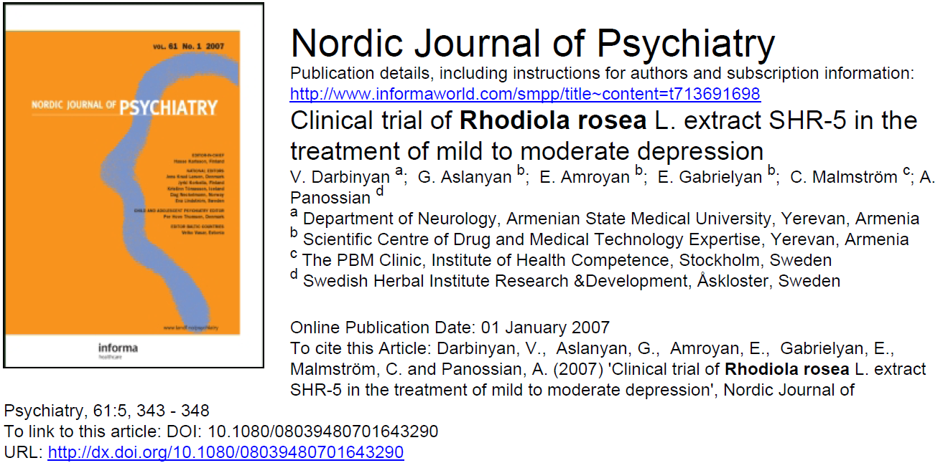
Rhodiola and Depression

Slide 29
Rhodiola and Depression
A standardized extract of Rhodiola trialled in patients with mild to moderate depression in dosages of either 340 or 680 mg/day over a 6-week period
At 340 mg/day depression, insomnia, emotional instability and somatization, improved significantly
At 680 mg/day self-esteem improved significantly
Energy levels ↑
Up-regulation of Hsp70
Darbinyan V et al. Nord J Psychiatry 2007; 61(15): 343-348
Notes:
HAMD: Hamilton rating scale for depression

Slide 30
Rhodiola & Ginseng Complex
Indications
Fatigue, physical stress, convalescence, failure to thrive
Debility, emaciation, cachexia,
Chronic fatigue syndrome, fibromyalgia, post-viral syndromes, chronic immune deficiency
Depression and anxiety
During chemotherapy or radiotherapy for cancer
To improve physical performance, impotence
To improve mental performance, concentration and memory, especially when under stress
As a tonic for the elderly and to enhance longevity

Slide 31
Adrenal Complex
Since the beginning of recorded history Licorice root has been used as a remedy
The ancient Assyrian, Egyptian, Chinese and Indian cultures were the first to document its use
Rehmannia root was first mentioned is Chinese texts around the 3rd century although herbs were used in China for millennia prior to this
In western herbal therapy both herbs are considered:
  Adrenal restoratives
  Improving the ability to adapt to occasional stress

Slide 32
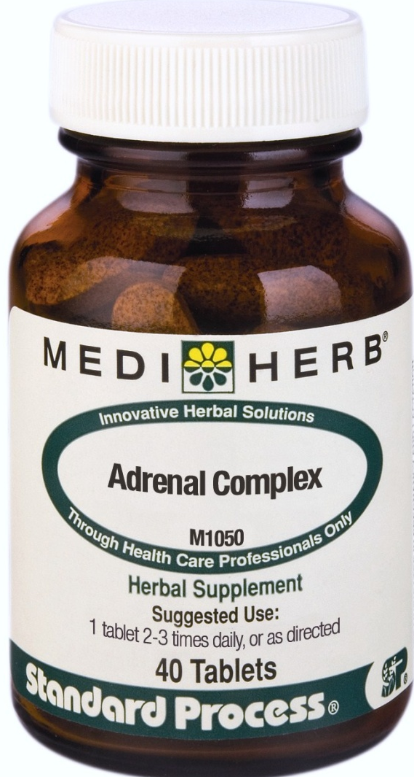
Adrenal Complex
Licorice root 7:1 ext 250 mg
from Glycyrrhiza glabra root 1.75 g
Containing glycyrrhizin 25mg
Rehmannia rhizome 5:1 ext 150 mg
from Rehmannia glutinosa
rhizome 750 mg
Dose: 1 tablet 2 -3 times per day
Notes:
Isoliquiritigenin from Licorice has 55% of the activity of resveratrol in vitro and is abundant in Licorice extracts³
Licorice contains triterpenoid saponins, especially glycyrrhizin, as well as flavonoids. Glycyrrhizin is an important active constituent.
The key constituents in Rehmannia are less well defined
There is extensive research supporting the use of Licorice and much is known about its mode of action in the body
Licorice and Rehmannia combine well to support both cortisol excess and cortisol deficiency
Licorice neither stimulates nor inhibits the production of cortisol, but rather preserves, protects & restores the cortisol producing machinery (adrenal cortex)
Where there is cortisol excess the adrenal glands are being overtaxed & where there is cortisol deficiency they are depleted
Either way there is the need for adrenal support

Slide 33
Adrenal Complex Indications
Adrenal depletion, to aid the recovery of the adrenal cortex
To support adrenal cortex function in times of high stress
Fatigue, anxiety, sleeplessness or reduced immune function during periods of prolonged stress
Chronic fatigue syndrome and fibromyalgia
Chronic illness, including autoimmune disease
Metabolic syndrome, visceral fat loss
Longevity?
Notes:
Colon Cancer

Slide 34
Licorice Safety
Licorice is safe when taken as recommended
In high doses and over a long period of time it can cause potassium depletion and hypertension
Glycyrrhizin the main active constituent in Licorice is converted to glycyrrhetinic acid (GA) in the intestine and absorbed
GA inhibits the activity of the enzyme 11 beta-hydroxysteroid dehydrogenase type 2 in the kidney
This allows cortisol to bind to mineralocorticoid receptors and exert an aldosterone like effect with the above mentioned side effects

Slide 35
High expression: Kidney, colon, salivary glands, placenta
Function: Protection of the mineralocorticoid receptor

Slide 36
Function:
Alteration of intracellular cortisol concentration
Organ specific enhancement of cortisol effect
High expression: Liver, adipose tissue, lung, gonads, pituitary, bone, eye
Notes:
Licorice inhibits this enzyme
11beta-hydroxysteroid dehydrogenase type 1 inhibitors as promising therapeutic drugs for diabetes: status and development.
Ge R, Huang Y, Liang G, Li X.
Source
School of Pharmacy, Wenzhou Medical College, 1# Jingguan Road, College Town, Wenzhou City 325035, China.
Abstract
Glucocorticoids (GC) play a fundamental role in controlling physiologic homeostasis and, when present in excess, can have a detrimental impact on glucose control, blood pressure and lipid levels. The oxidoreductase 11beta-hydroxysteroid dehydrogenase type 1 (11beta-HSD1) mainly catalyzes the intracellular regeneration of active GCs (cortisol, corticosterone) from inert inactive 11-keto forms (cortisone) in liver, adipose tissue and brain, amplifying local GC action. Multiple lines of evidence have indicated that 11beta-HSD1-mediated intracellular cortisol production may have a pathogenic role in type 2 diabetes and its co-morbidities. The 11beta-HSD1 becomes a novel target for anti-type 2 diabetes drug developments, and inhibition of 11beta-HSD1 offers a potential therapy to attenuate the type 2 diabetes. In the past several years, a lot of 11beta-HSD1 inhibitors have been designed, synthesized, screened and discovered. Lowering intracellular glucocorticoid concentrations through administration of small molecule 11beta-HSD1 selective inhibitors, significantly attenuates the signs and symptoms of disease in preclinical animal models and clinical trials of diabetes and metabolic syndrome. Among published inhibitors, DIO-902 from DiObex Inc. and INCB13739 from Incyte Inc. are now being investigated under Phase 2B clinical trials. However, the selectivity of current selective 11beta-HSD1 inhibitors has been just focused on the difference between 11beta-HSD1 and 11beta-HSD2. They inhibit the bi-directional activities of 11beta-HSD1, both 11beta-HSD1 reductase (major) and oxidase (minor). In our lab, we have recently found novel chemicals that not only inhibit 11beta-HSD1 reductase activity but also increase its oxidase activity without inhibition against 11beta-HSD2. We propose that this dual modulation on 11beta-HSD1 may provide a better therapeutic strategy for type 2 diabetes.

Slide 37
Licorice and Central Obesity
Italian scientists have shown that Licorice for 2 months reduced body fat mass in 15 healthy volunteers without any change in calorie intake. BMI did not change¹
Also showed that topical application of glycyrrhetinic acid for one month reduced the thickness of subcutaneous thigh fat (placebo-controlled trial) ²
1 Armanini D et al. J Endocrinal Invest 2003; 26(7): 646-650
2 Armanini D et al. Steroids 2005; 70: 538-542
Notes:
Licorice is well documented to inhibit the activity of 11 beta-HSD type 2. This is responsible for its aldosterone-like side effects

Slide 38
Licorice
Cautions & Contraindications
Contraindicated in hypertension & edema
Caution is advised in patients taking cortisol or prednisolone, & in the elderly & those with cardiac, renal or hepatic disease
Do not prescribe if patient is taking potassium-depleting diuretics
Patients who are prescribed Licorice preparations high in GL for prolonged periods should be placed on a high potassium & low sodium diet
And closely monitored for blood pressure increases & weight gain

Slide 39
General Adrenal Support
Adrenal Complex, 1 tablet 2 to 3 times daily
Drenamin, 6 tablets daily
Catalyn (3 to 6 tablets per day)
For added vitality and energy and for prevention of stress related immune and neuroendocrine disorders
Rhodiola & Ginseng Complex , 1 tablet 2 to 4 times daily

Slide 40
The MediHerb Adaptogens
Astragalus Complex
Bacopa Complex
Eleuthero
FemCo
Gotu Kola Complex
HerbaVital
LivCo
Nevaton
Rhodiola & Ginseng Complex
Thyroid Complex
Withania Complex

Slide 41
Additional Herbal Support
Valerian Complex, 3 to 4 tablets per day
  Insomnia, Anxiety
Nevaton, 3 to 4 tablets per day
  Nervous system support, Depression
St John’s Wort, 3 to 4 tablets per day
  Depression
Ginkgo Forte, 2 to 4 tablets per day
  Neuroprotection, Depression, Stress

Slide 42
Thankyou
Special thanks to Associate Professor Kerry Bone and Rob Santich for their contributions to this material

